Slide 1

CIS 731 Final Project
Multivariate Time Series Weather Forecasting
By
Tejas Dinesh Patil
Yeswanth Reddy Velapalem

Slide 2
Introduction
Time series is an important variation of the data-form that encapsulates historic data.
Various techniques like AR, MA, ARIMA etc. are used for time series forecasting.
Our aim here is to use Artificial Neural Networks for temperature forecasting.
Implementing both Univariate forecasting and Multivariate forecasting.
The goal of this project is to implement and compare various types of neural networks based on the results obtained.
These architectures will be compared on the grounds of loss calculated (mean squared error) and the computational effort required to train the neural network models.

Slide 3
Data Description
The dataset that we are planning to use for our project is a weather time series data collected by the research institute named ‘Max Planck Institute of Biogeochemistry’ located in Jena, Germany.
The dataset provided by the institute is a multivariate time series dataset. This time series data is recorded over a span of 7 years starting from Jan 01, 2009 to December 31, 2016.
The dataset consists of 14 weather related attributes and a total of 420,550 observations. Every observation is recorded at the frequency of 10 minutes. Out of those 14 attributes, based on our problem statement we plan to use the Temperature attribute (in Kelvin) as the target variable and forecast the values.

Slide 4
Features
p (mbar): Pressure in millibars | VPdef (mbar): Vapor Pressure deficit
T (deg C): Temperature in Celsius | sh (g/kg): Specific Humidity
Tpot (K): Temperature in Kelvin | H2OC (mmol/mol) :Water Vapor concentration
Tdew (deg C): Temp. relative to humidity | rho (g/m**3): Airtight
rh (%): Relative humidity | wv (m/s): Wind Speed
VPmax (mbar): Saturation Vapor Pressure | max. wv (m/s): Maximum Wind Speed
VPact (mbar): Vapor Pressure | wd (deg): Wind direction in degrees

Slide 5
Data Preprocessing & EDA
Sampling the data
Hourly data is taken since the temperature doesn’t show any changes for every 10 minutes
Missing Values
There were no missing values in the data
Trendline Analysis
To see the behaviour over time. Since this is weather data we saw a seasonal trend
Incorrect data
Wind Speed has negative values

Slide 6
Data Preprocessing & EDA
Outlier treatment
Outliers were treated using the IQR method.
Correlation Matrix
We plotted a correlation matrix to see if there is any relation between the features.
Found high correlation between ‘Specific Humidity’, ‘Water Vapor Concentration’ and ‘Vapor Pressure’.

Slide 7
Feature Engineering
Removing redundant features
Only one feature is retained from the features that are correlated to each other
Generating Wind vectors from Wind Speed and Direction
Since Wind Speed and Direction are not directly helping with the forecasting, we created Wind vectors using this data. These vectors indicate direction and intensity of the wind
Scaling the data
The range of values of data vary widely. As Neural Networks are distance based algorithms, we should bring all the features under a single scale

Slide 8
Sequence Generation
Univariate single value forecasting
Multivariate single value forecasting
Multivariate sequence to sequence forecasting

Slide 9
Approach & Algorithms
Feed Forward Neural Network
Supervised Learning
Univariate Forecasting
Recurrent Neural Network
Univariate Forecasting
Multivariate Forecasting

Slide 10
Approach & Algorithms
Long Short Term Memory Network
Univariate Forecasting
Multivariate Forecasting
Sequence 2 Sequence Model
Bi-directional Model
Gated Recurrent Units
Univariate Forecasting
Multivariate Forecasting
Sequence 2 Sequence Model

Slide 11
Approach & Algorithms
Convolutional Neural Networks
Univariate Forecasting
Multivariate Forecasting

Slide 12
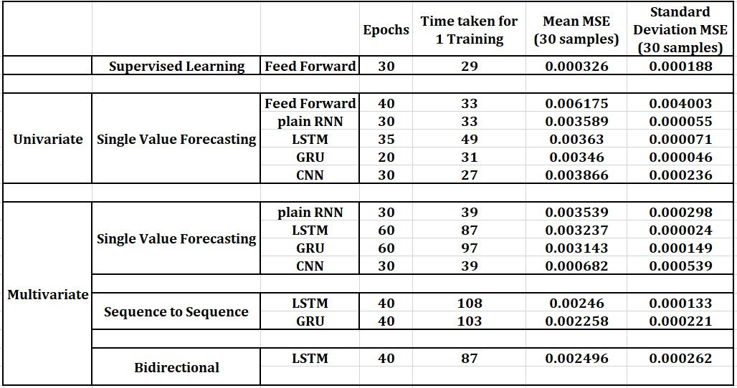

Evaluation

Slide 13
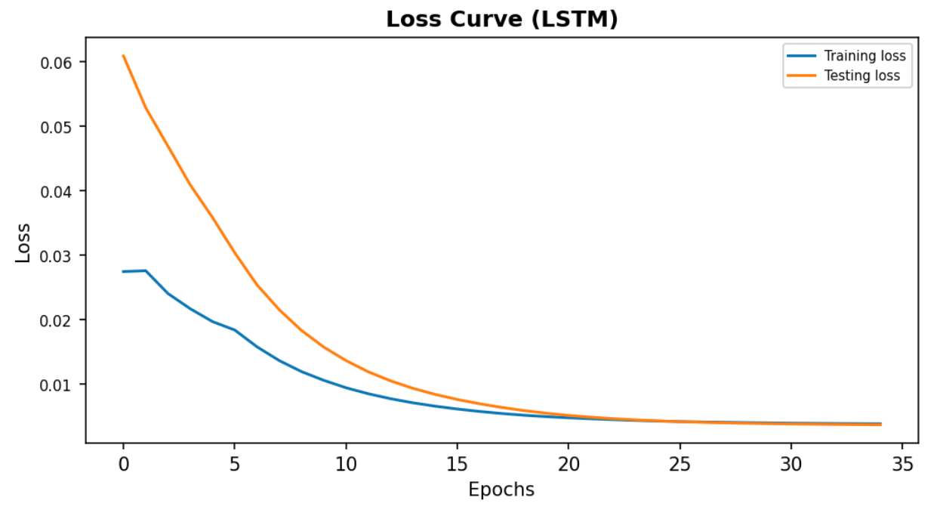
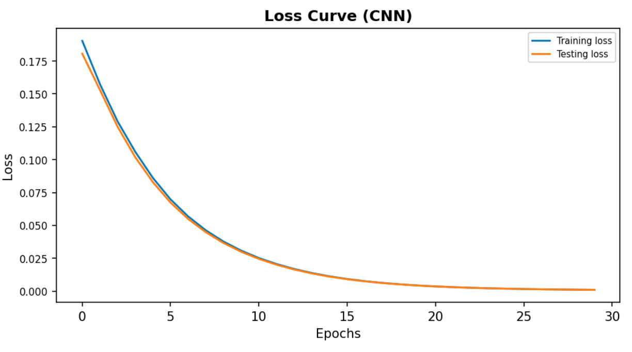
Results (Loss Curves)
Univariate Forecasting
Multivariate Forecasting

Slide 14
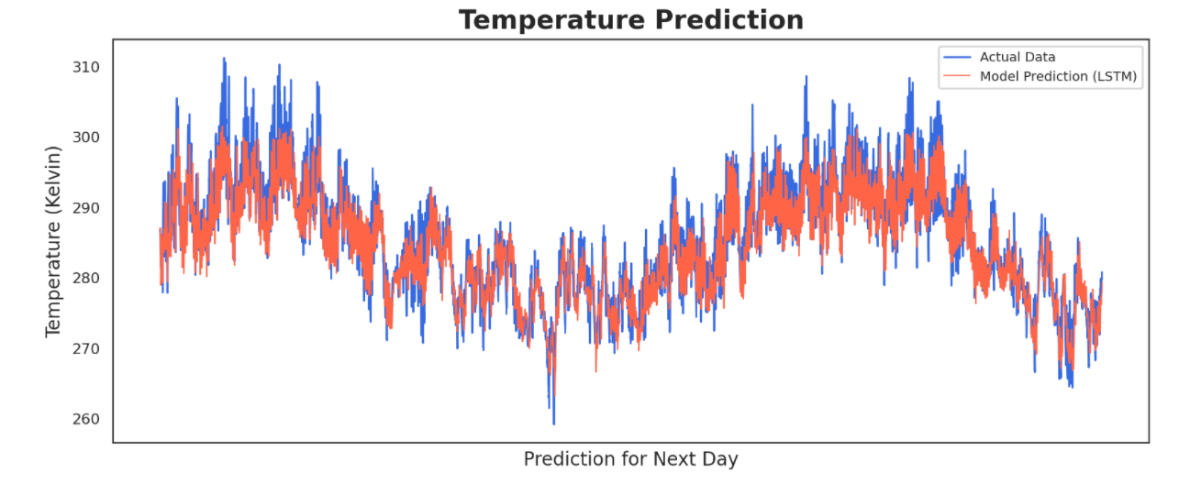
Results (Actual vs Prediction values)
Sequence 2 Sequence LSTM

Slide 15
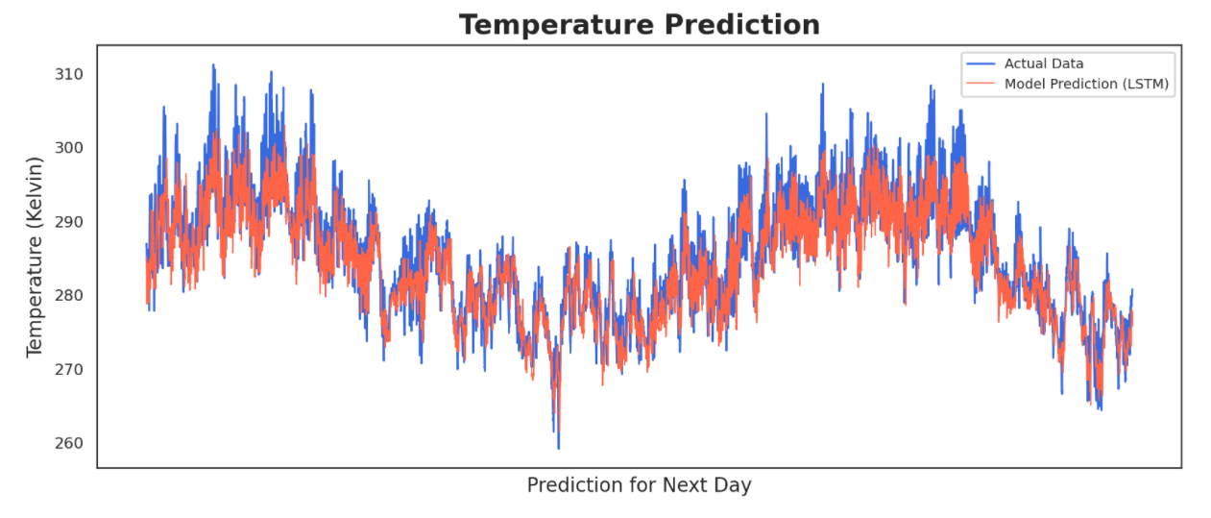
Results (Actual vs Prediction values)
Sequence 2 Sequence Bi-directional LSTM

Slide 16
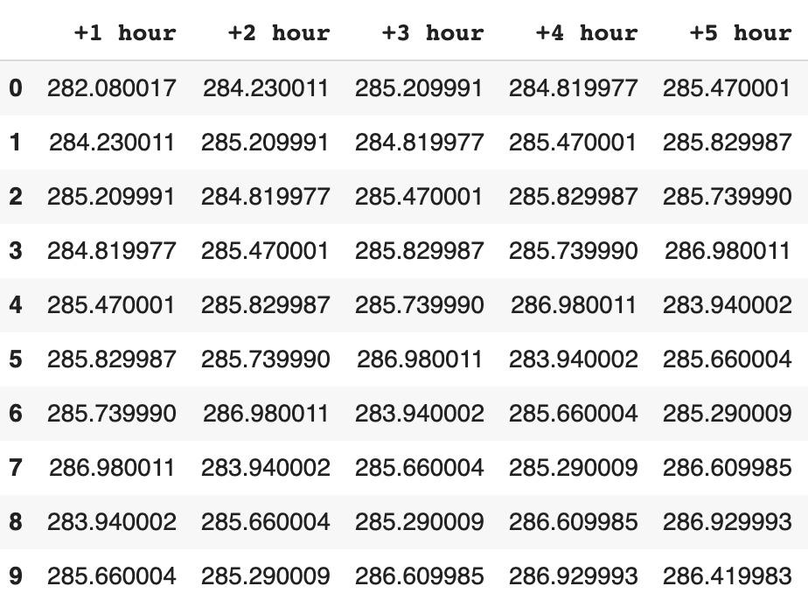
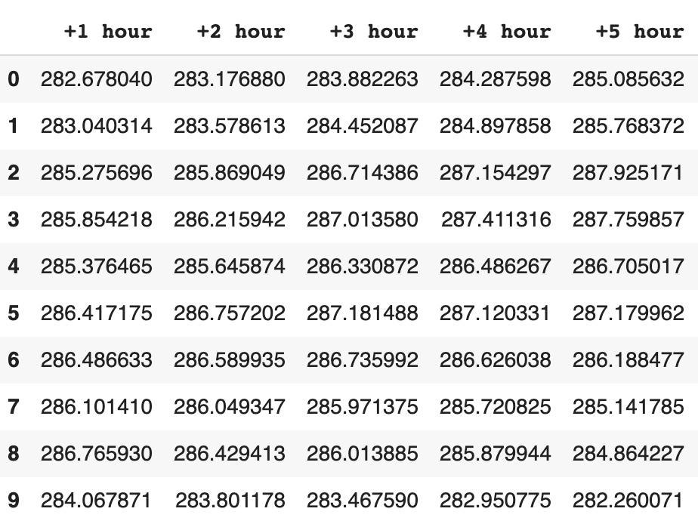
Seq2Seq Bi-directional LSTM (Actual vs Forecasted)
Original Values
Forecasted Values

Slide 17
Conclusion
Amongst all the multivariate models trained for single value forecasting, CNN is the best performing model with respect to the MSE obtained as well as the computational effort: convolutional filters help get rid of the unwanted data.
Bi-directional LSTM trains in 87 seconds while it takes a little more than 100 seconds for unidirectional LSTM and GRU networks: Keeping the same performance, bidirectional LSTM trains faster than unidirectional LSTMs and GRUs.
Feed-forward network did not perform well with time series forecasting. The MSE increased to 0.006175 (STD: 0.004003) from 0.000326 (STD: 0.000188) for supervised learning. Also, this MSE value is nearly twice of MSE that was achieved for other networks (univariate single value forecasting).
Except for the CNN, adding more variables (multivariate) does not improve the performance of the model. For all the other networks, the mean MSE stays in the range 0.003 to 0.0035.

Slide 18
Future Scope/Discussion
Combine the power of CNN and memory cells of LSTM into a single architecture.
Forecasting the temperature over a longer range of values. For e.g., using daily average temperature from the past 2-3 months to predict the temperature in the longer future.

Slide 19
Appendix:
Work Done After 1st December:
All the models were trained for 30 iterations and final MSE values on the test data were collected.
A final successful attempt was made to tune the multivariate sequence to sequence GRU and multivariate sequence to sequence bidirectional LSTM.
Link to updated codes can be found below:
https://github.com/yeswanthrs9/CIS-731/tree/main/CIS%20731%20Project

Slide 20
Thank You!

